Slide 1
Switching and Routing, Project 7:
Node failure detection in a ring.
Group 11: Bernardo Camajori Tedeschini, Fabio Losavio, Luca Ferraro, William Colombo, Simone Tonelli.
28/02/2020

Slide 2
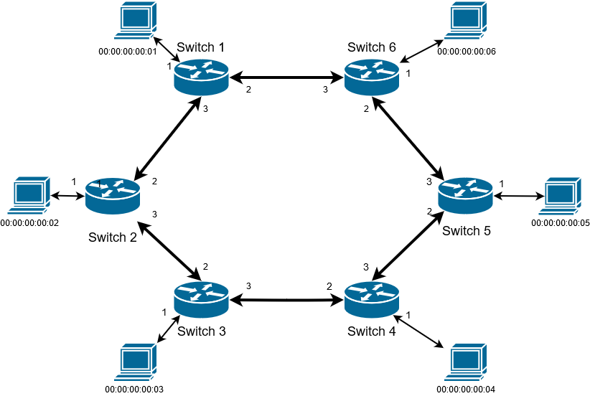
Objective of the project: handling the failure of a node
Reactive mode:
Switch going down sends a message to the controller.
Controller handles these real-time messages.
Node failure
Proactive mode:
Controller checks switches status.
Presence/absence of a response is used to manage flow tables.

Slide 3
A-priori procedures: topology discovery
Switches and links discovery.
A host discovered when it sends a message.
Proactive storage of shortest paths → topology matrix.
Entry (i, j) = shortest path from switch i to switch j.
Example: S1 to S4 → S1 forwads the packet to S2.
 | S1 | S2 | S3 | S4 | S5 | S6
S1 | 1 | 1, 2 | 1, 2, 3 | 1, 2, 3, 4 | 1, 6, 5 | 1, 6
S2 | 2, 1 | 2 | 2, 3 | 2, 3, 4 | 2, 1, 6, 5 | 2, 1, 6
S3 | 3, 2, 1 | 3, 2 | 3 | 3, 4 | 3, 4, 5 | 3, 2, 1, 6
S4 | 4, 3, 2, 1 | 4, 3, 2 | 4, 3 | 4 | 4, 5 | 4, 5, 6
S5 | 5, 6, 1 | 5, 4, 3, 2 | 5, 4, 3 | 5, 4 | 5 | 5, 6
S6 | 6, 1 | 6, 1, 2 | 6, 1, 2, 3 | 6, 5, 4 | 6, 5 | 6

Slide 4
Reactive application
Compute matrix from scratch
Restore all flows
T
All Switches are UP
T
Switch UP
F
Update flows towards switch that wakes up
event_dp_handler
Topology update
F
Modify table entries that contain the switch
Update Flows

Slide 5
Proactive application
We maintain a flag for each switch → 1: switch up, 0: switch down.
Switch_status
(every 5 seconds)
event_dp_handler (as reactive, case switch up)
_request_stats
(asks for flow status)
Flags = 0
T
Switch UP
T
F
Switch was already down
F
Topology updated
Modify table entries that contains the switch
Update flows
_flow_stat_reply_handler
Flag of the switches sending flow stats = 1

Slide 6
Test scenario: reactive mode
Test between H1 (connected to S1) and H3 (connected to S3).
At the beginning all switches are up: S1 → S2 → S3.
S2 is stopped: S1 → S6 → S5 → S4 → S3.

Slide 7
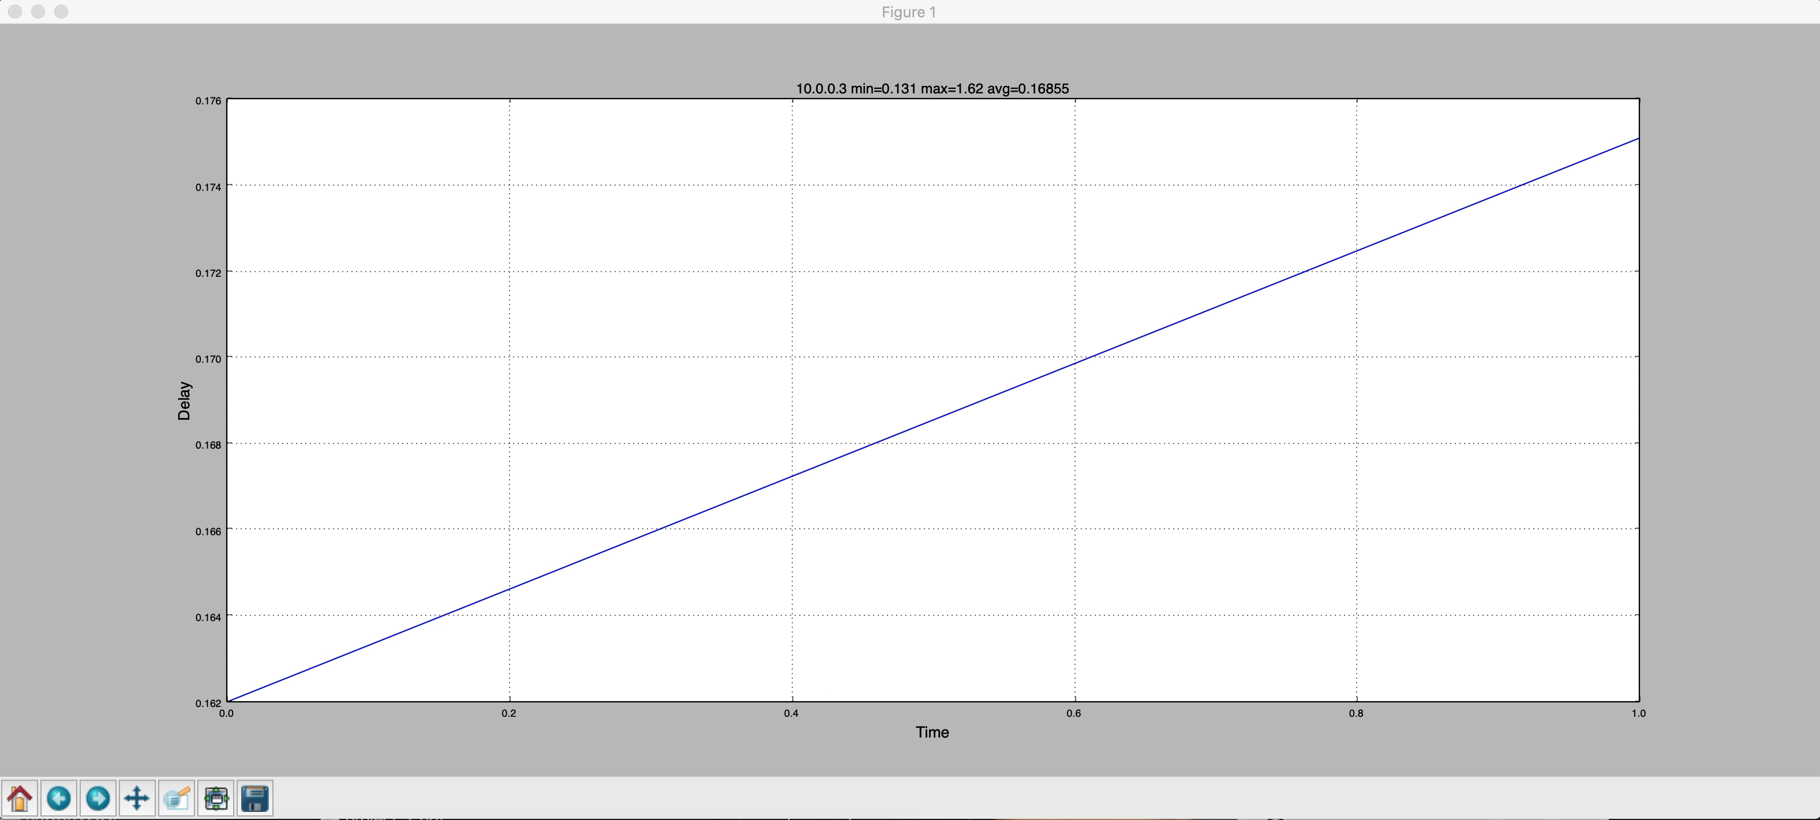
Test delay (PING): reactive mode
Initial delay due to ARP lookup.
S2 is down, one packet is lost, delay increases since the next packet matches the table miss rule and is processed by the controller.

Slide 8
Test scenario: proactive
Test between H1 and H3.
At the beginning all switches are up: S1 → S2 → S3.
S2 is stopped at t0: topology is not updated until the second check (max 10s) →
All packets sent in this interval are lost.
Packets lost
t1
t2
t0
t3
t4
t5
t
S2 flag set to 0

Slide 9
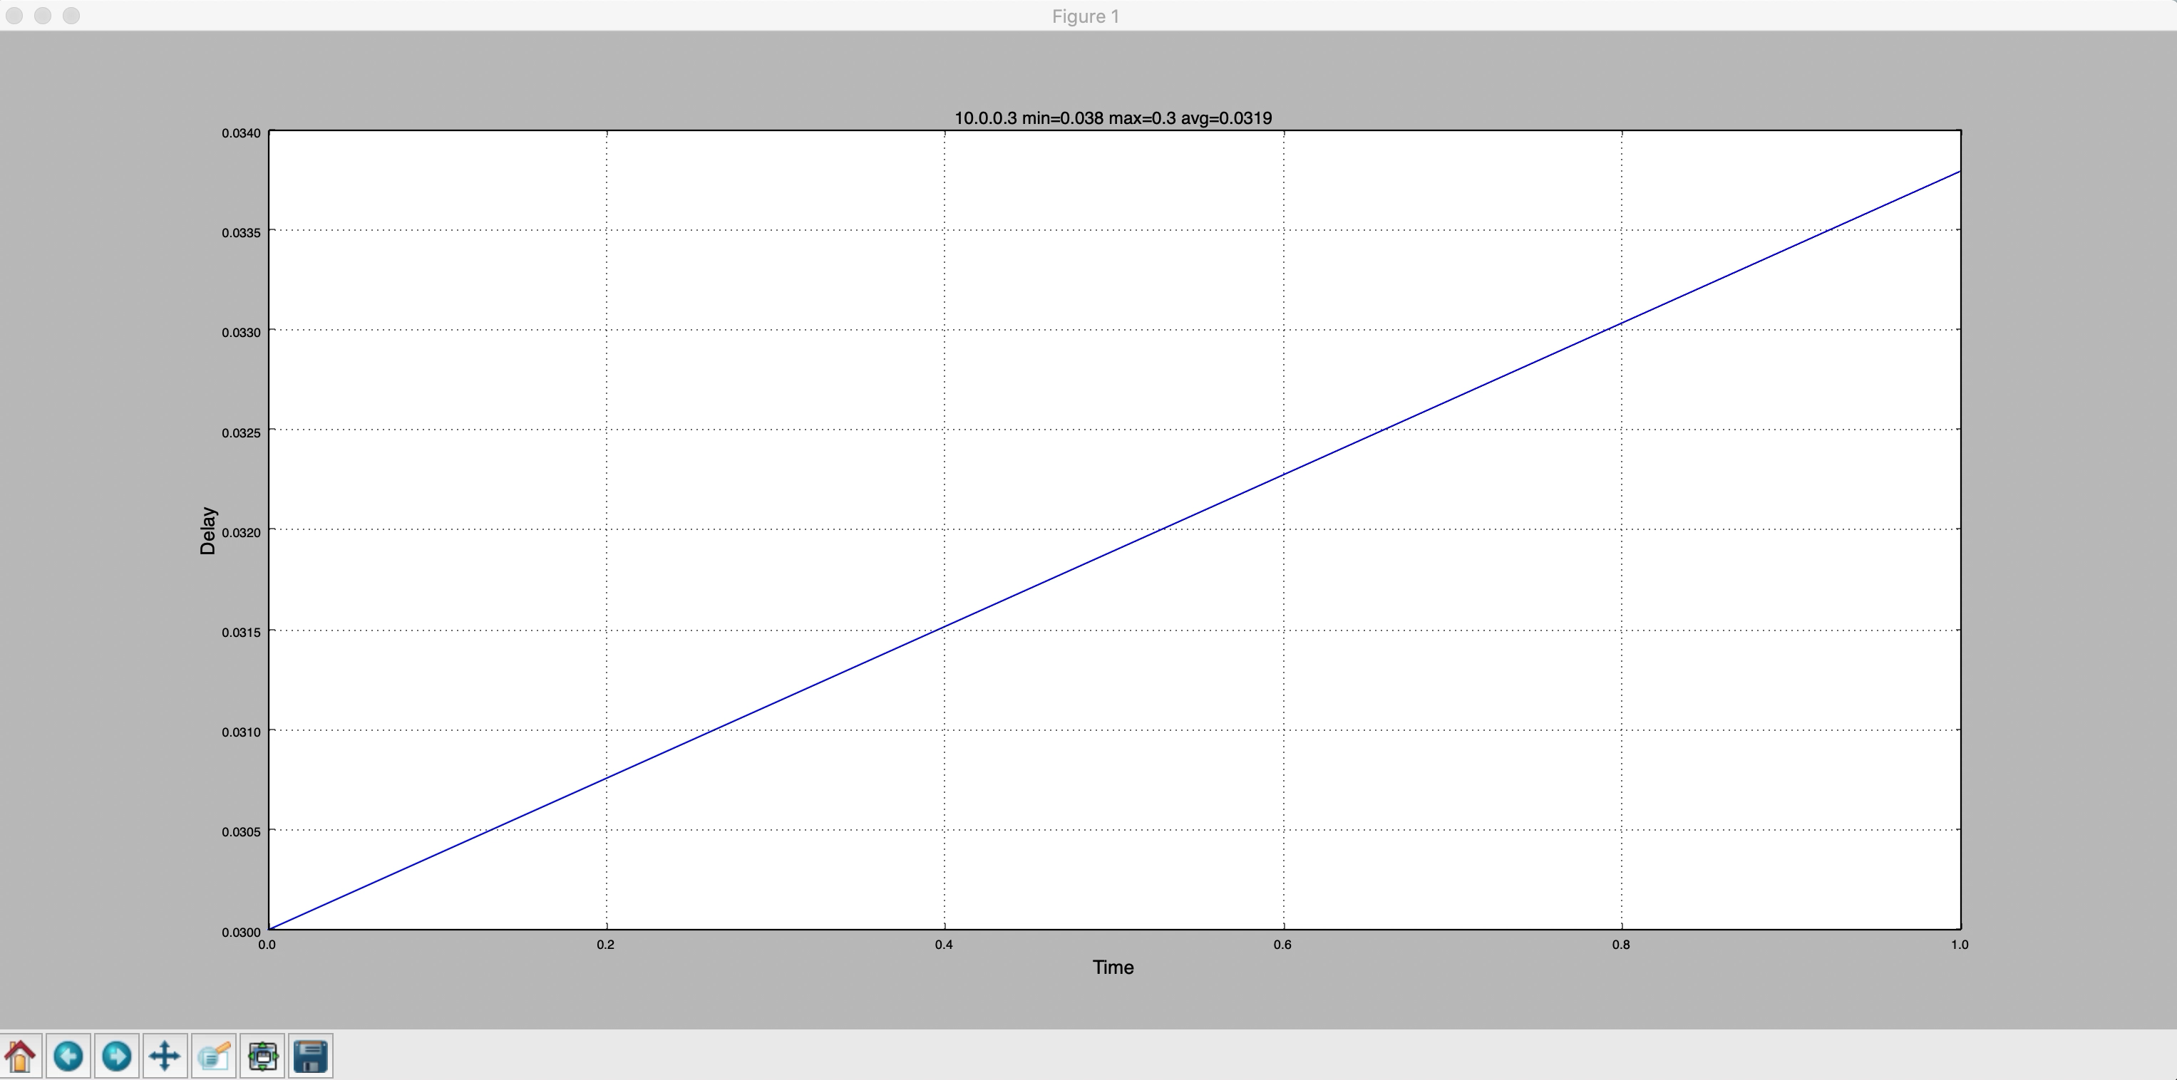
Test delay (PING): proactive mode
Initial delay due to ARP lookup
delay increases since the next packet matches the table miss rule and is processed by the controller.
S2 goes down, ten packets are lost, no ping is detected.

Slide 10
Results: delay, packet loss
H1 ping H3 | AVG Pkt Delay (base case) | Number of packets lost | Failure reaction time
Reactive mode | 0.0429 sec | 1 pkt | Max 1 sec
Proactive mode | 0.0327 sec | 10 pkt | Max 10 sec

Slide 11
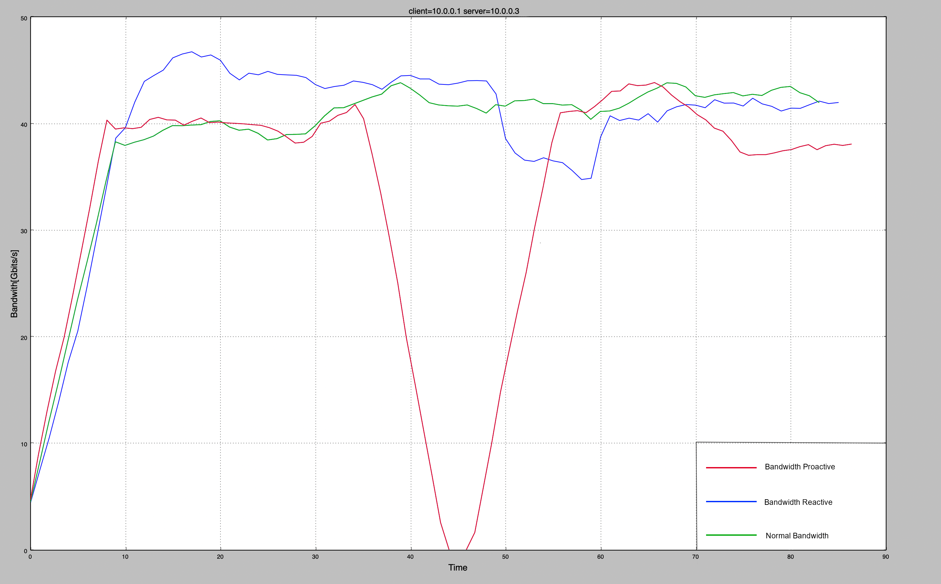
Test Bandwidth statistics (IPERF): reactive and proactive modes
Slower computation determines a bandwidth reduction
Packets are lost so the bandwidth is 0

Slide 12
Results: Bandwidth statistics [Gbps]
Client H1, Server H3 | Average | Max | Min
Reactive mode | 39.6 | 55.6 | 34.6
Proactive mode | 25.5 | 39.3 | 0

Slide 13
Results
Delay and packet loss:
Reactive app: controller reacts in a shorter time → only one packet is lost.
Proactive app: long failure reaction time → more packets are lost.
Bandwidth:
Reactive app: small bandwidth reduction.
Proactive app: connection is stopped due to the failure reaction time.

Slide 14
Conclusions
In this project we developed a proactive and a reactive application in order to manage the failure of a node in a ring.
We have collected statistics on the delay and the bandwidth using both the applications.
Both the applications works with every topology, with the constraint that each switch must have at most one host linked.

Slide 15
THANKS FOR
YOUR ATTENTION

